Slide 1
HTML5 and Mobile Web Application Development

Slide 2
Bio
12+ years HTML/CSS/JavaScript. Focused on those technologies since 1999
Interface Architect at Isobar
I work with cool companies- Adidas, Philips, Harvard, Gillette, Compete, Museum of Science Boston, State Street
Twitter: @robreact
Blog: htmlcssjavascript.com
Notes:
I’ve watched the arc of these technologies go from the dumps in the early 2000s to now where it’s the hottest toolset on the job market

Slide 3

What is HTML5?
Notes:
Html5 is both a specification, an actual document you can go read, and a blanket marketing term

Slide 4
What is HTML5?
"HTML5 is anything you want it to be as long as it's new and cool.“ – Peter Paul Koch
http://www.quirksmode.org/blog/archives/2010/01/html5_means_wha.html
Notes:
Dutch javascript developer puts it pretty well…

Slide 5
The Web Platform
HTML5
New Semantic elements
Video and audio
Form elements and input types
Offline Web Applications
Related Technologies
SVG
Canvas
Geolocation
Web Storage
Notes:
The W3C has given it another name, one that’s really more accurate “the web platform”. Some of the more interesting examples here are
-Video and Audio, which clearly have already made a splash,
-the new Semantic elements, which better describe the way we actually build web pages
-SVG, Canvas and WebGL which bring powerful graphics capabilities into the browser
-Geolocation which is a blindingly simple API which brings the sense of place into the browser

Slide 6
The Web Platform
WebSocket
WebGL
EcmaScript, 5th Edition (ES5)
CSS3
2D Transforms
3D Transforms
CSS Animations
CSS Transitions
For a full rundown on these technologies see my article HTML5, CSS3, and related technologies
(http://www.ibm.com/developerworks/web/library/wa-webstandards/index.html)
Notes:
-ES5 which enhances JavaScript, the language that drives interactivity on the web
-Animations, transitions and transforms, which allow for CSS-based effects.

Slide 7

Add It All Up
Notes:
This is another sentiment put forth by the W3C

Slide 8
What Does That Really Mean
Much better tools for developing and deploying rich, interactive applications over the web.

Slide 9

Front End Engineers Are Really Happy
Happy Front End Engineers
Group Shot! From kurafire http://www.flickr.com/photos/kurafire/4112642903/
Notes:
In case you’re wondering, this is from JSCONF.eu

Slide 10

On the Desktop It’s Not Quite “The Future” Yet
Notes:
The popularity of IE6 and IE7 is a real problem. IE8 is a pretty good browser, but it still doesn’t support a lot of what we want it to support in terms of emerging technologies.

Slide 11
Although We Can (and do) Make it Work
Raphaël – SVG Support
Excanvas – Canvas Support
Amplify.js – Client Side Storage
Html5shim – New, Semantic elements
innerShiv – Dynamic Semantic elements
History.js – History API
css3pie – CSS3 Features
Flexie - Flex box support
Respond – Media Query Support
ETC
Notes:
These libraries help fill in the gaps by cleverly using proprietary IE technologies or other hacks to fill in the gaps in the standard

Slide 12
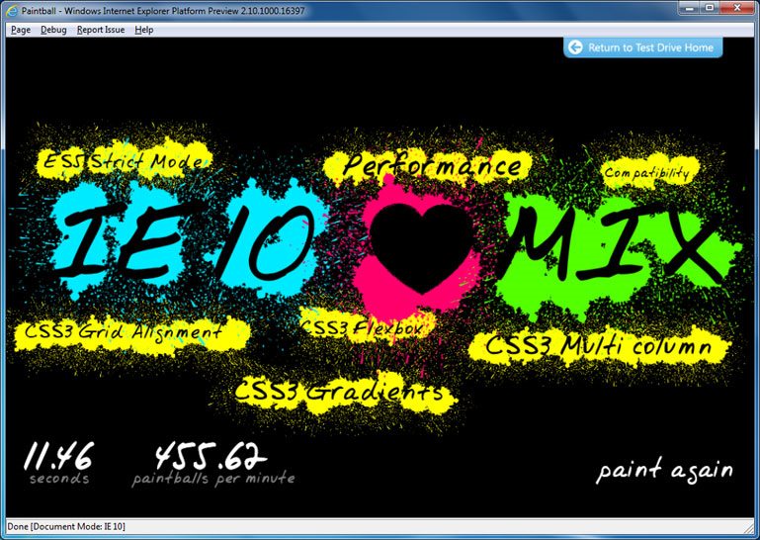
And I Should Point Out…
IE9 is a great browser& IE10 will be even better.
Crazy Emerging Tech Demo>

Slide 13
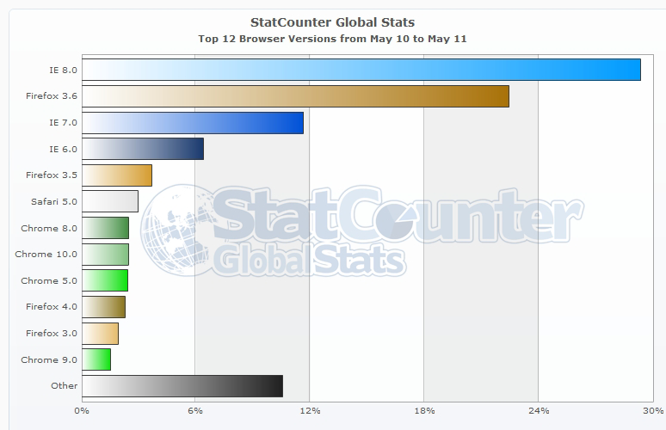
BUT, Still: ~50%
Taking advantage of this stuff now takes dedication and a knowledgeable front end engineering team, especially if your particular audience skews toward older IE versions.
Source: http://gs.statcounter.com/#browser_version-ww-monthly-201005-201105-bar
Notes:
Still, we’re working at around 50%. We can do it, and we do- we work with HTML5 technologies on mass-market production sites right now. It just takes dedication and knowledge.

Slide 14
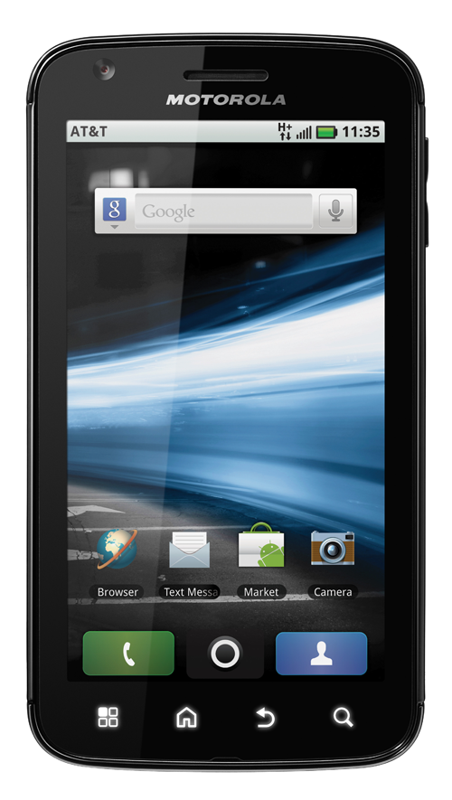
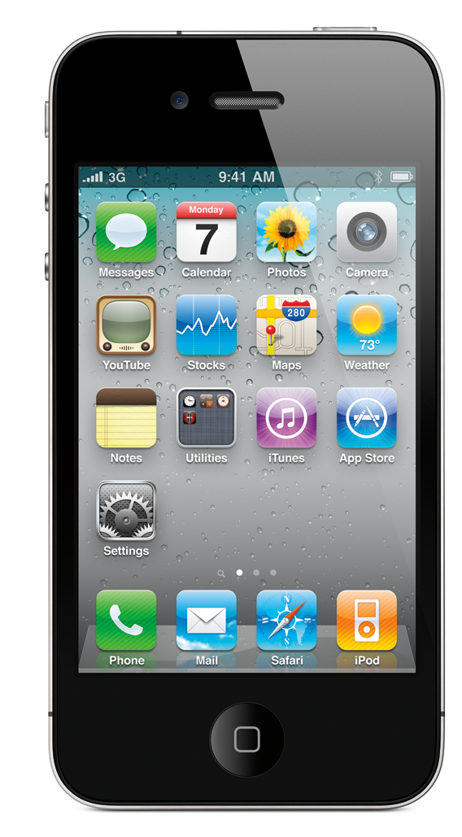
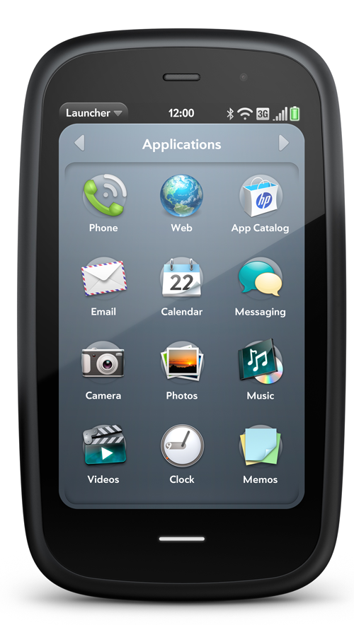
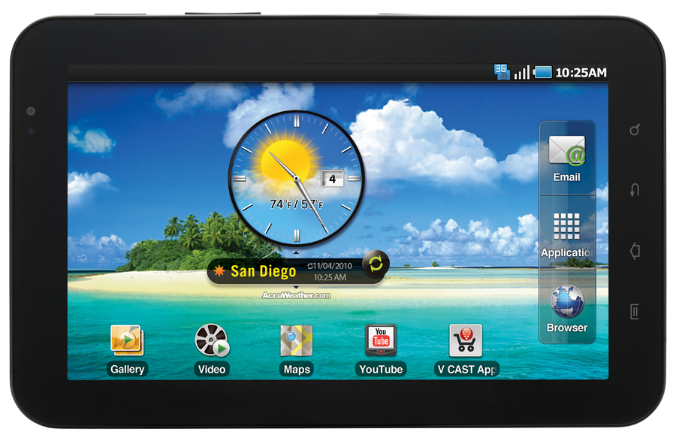
Mobile is a Different Story
These are REALLY Good browsers
Notes:
These are all good browsers with decent support for the real emerging technologies. It’s a more straightforward experience developing for these webkit based browsers.

Slide 15
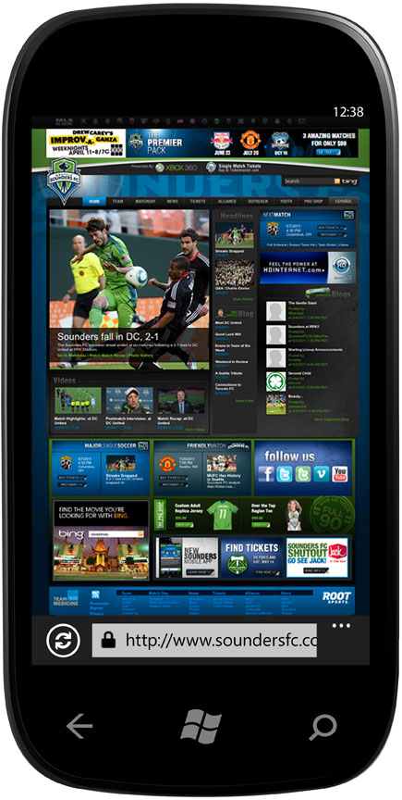
(In case you were wondering) This Will Have a Really Good Browser
(that’s IE9)
Notes:
This won’t be webkit, but it will be IE9 in Win Phone 7. We can work with that.

Slide 16
No Wonder We’re Excited
We can now build with one common set of APIs and provide engaging experiences for iOs, Android, BlackBerry, WebOS, and Windows Phone 7 devices.
Notes:
And the technologies are pretty well understood. There are people like me out there who have five-ten years of experience building web apps with W3C technologies. If a front end engineer is paying attention, moving into HTML5 is a pretty straightforward (and exciting) experience.

Slide 17

Also, for better or worse
iOS=
(Kind of a big deal)
“No Flash Photography of This Exhibit Case Please!” Leo Reynolds http://www.flickr.com/photos/lwr/12906579/
Notes:
Which means we really have to push into mobile web apps to get some types of content onto iOS devices. Even if it wasn’t exciting it would be a need. Thankfully, as F2Es, we’re happy to play in this space.

Slide 18
We Don’t Have to Leave the Desktop Behind
With an all-encompassing design approach and an intelligent implementation, your mobile web app is just a web app that works like a charm on mobile.
Your potential audience just jumped from tens to hundreds of millions (or billions, depending on how global your audience is and how well you handle older versions of IE.)
This is also very powerful if you’ve got a limited set of browsers/devices to target on an Intranet.
Notes:
This is important. We have technologies and patterns ALREADY in place that will help us build apps that will work in any device.

Slide 19



Yes, There are Tools
Notes:
There are tools out there already to help smooth development of mobile apps.

Slide 20
They’re Here to Help
jQuery Mobile
Dojo Mobile mobile focused versions of popular JS libraries
Sencha Touch Mobile specific Model-View-Controller (MVC) platform

Slide 21
It’s Not Perfect
You don’t have full access to the device and device APIs
“Webkit” doesn’t always what you think it means (and that’s ignoring any other mobile browser.) That means lots of testing if you’re going for broad support.
No app store

Slide 22
But it’s Still Pretty Good
…and it’s only going to get better

